Slide 1
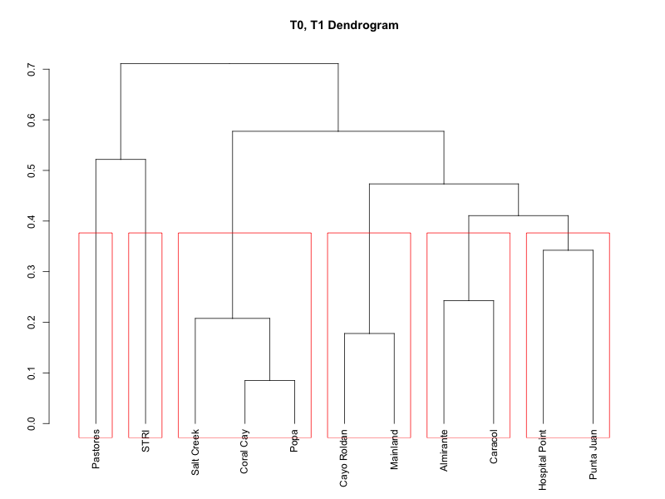
Notes:
EDITS:

Slide 2
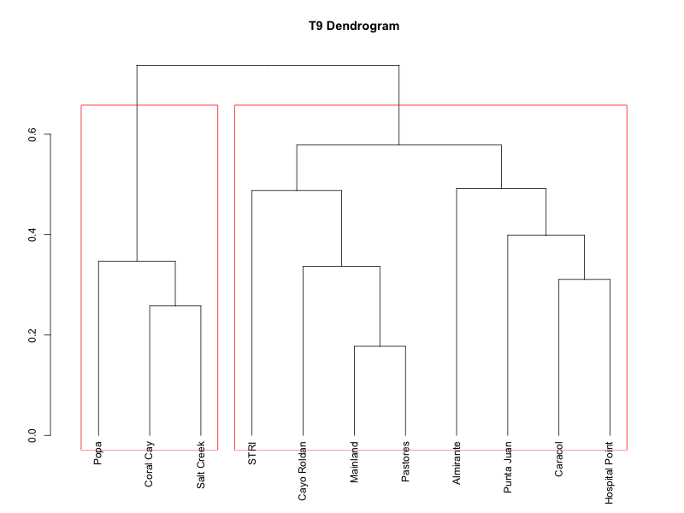
Notes:
Edits: SIMPROF, pull T0/T9 comparison

Slide 3
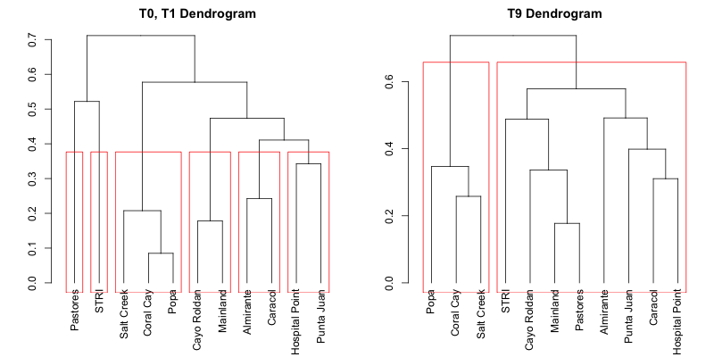

Slide 4
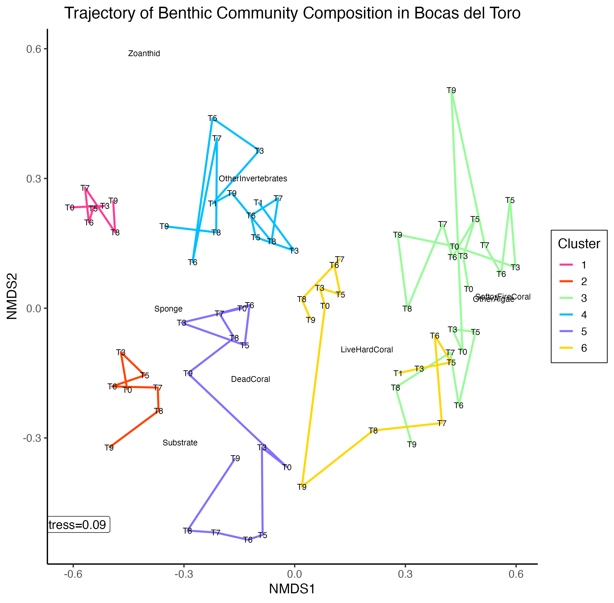
T0, T1 Clusters

Slide 5
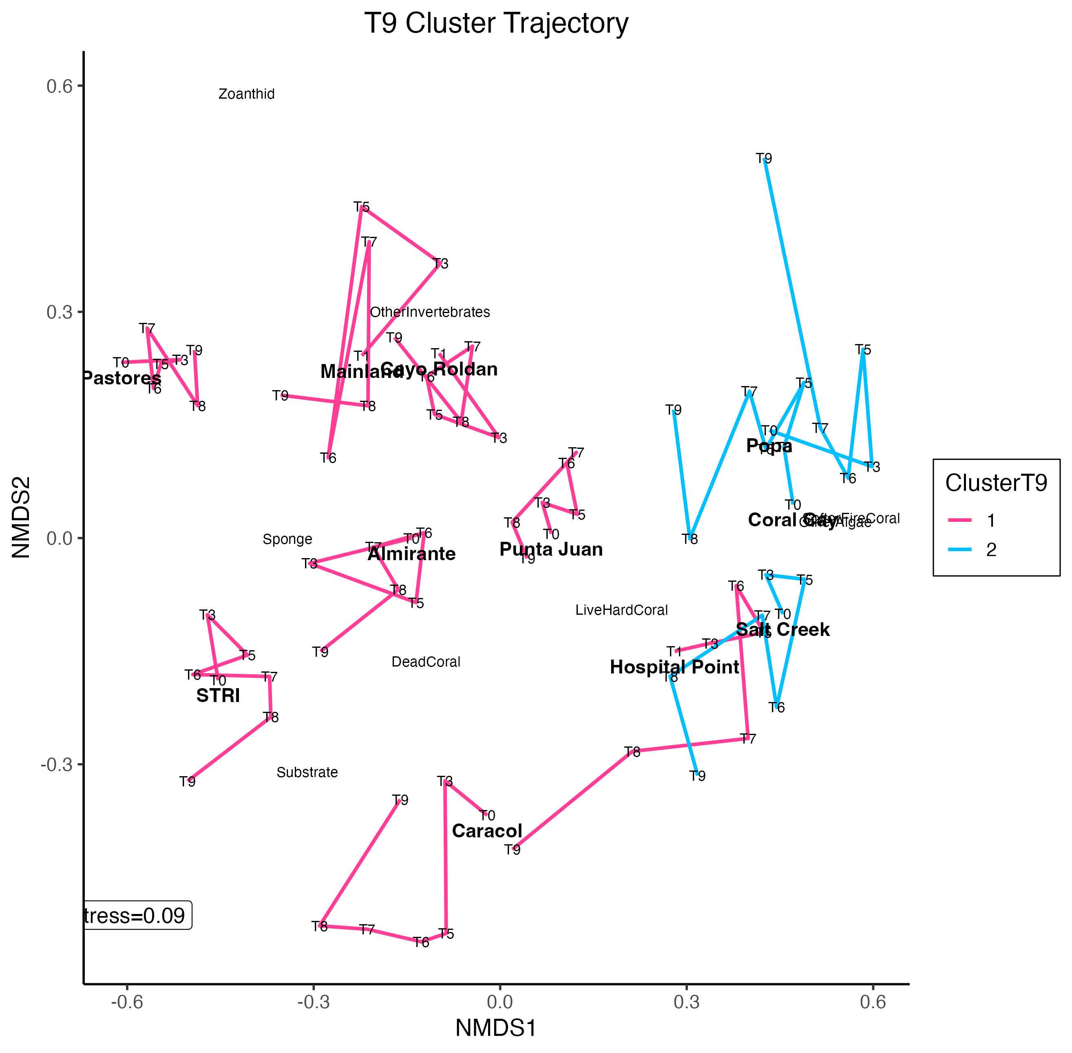
Notes:
Can explore editing in Illustrator

Slide 6
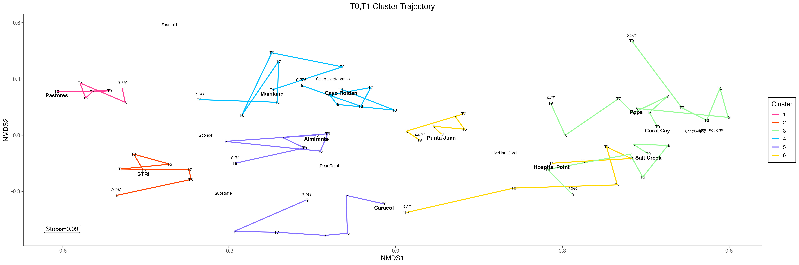
Notes:
Includes Euclidean distances @ T9

Slide 7
Notes:
Reef builders = coral, fire coral, CCA, colors represent initial clustering
EDITS: Color based on T9 clusters, include time points on x-axis

Slide 8
Notes:
Reef builders: hard coral, fire coral, CCA
Fleshy Organisms: sponge, zoanthid, fleshy macroalgae

Slide 9
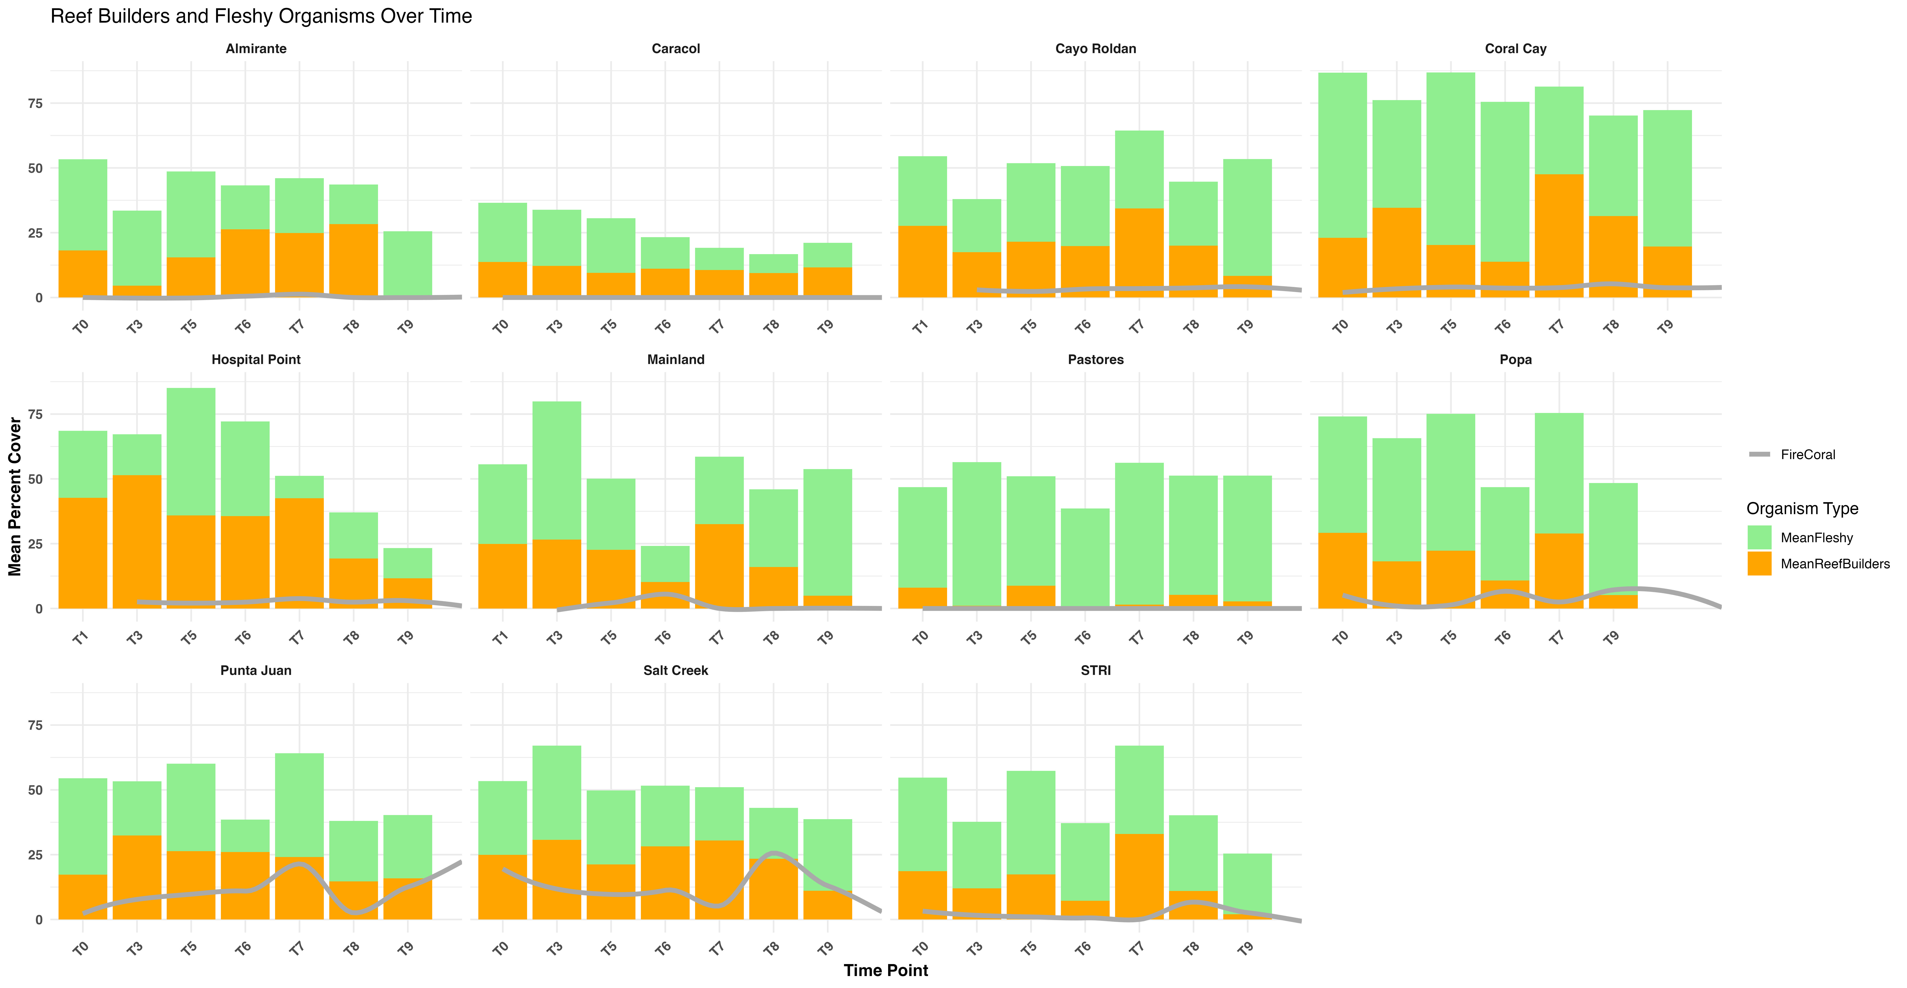

Slide 10
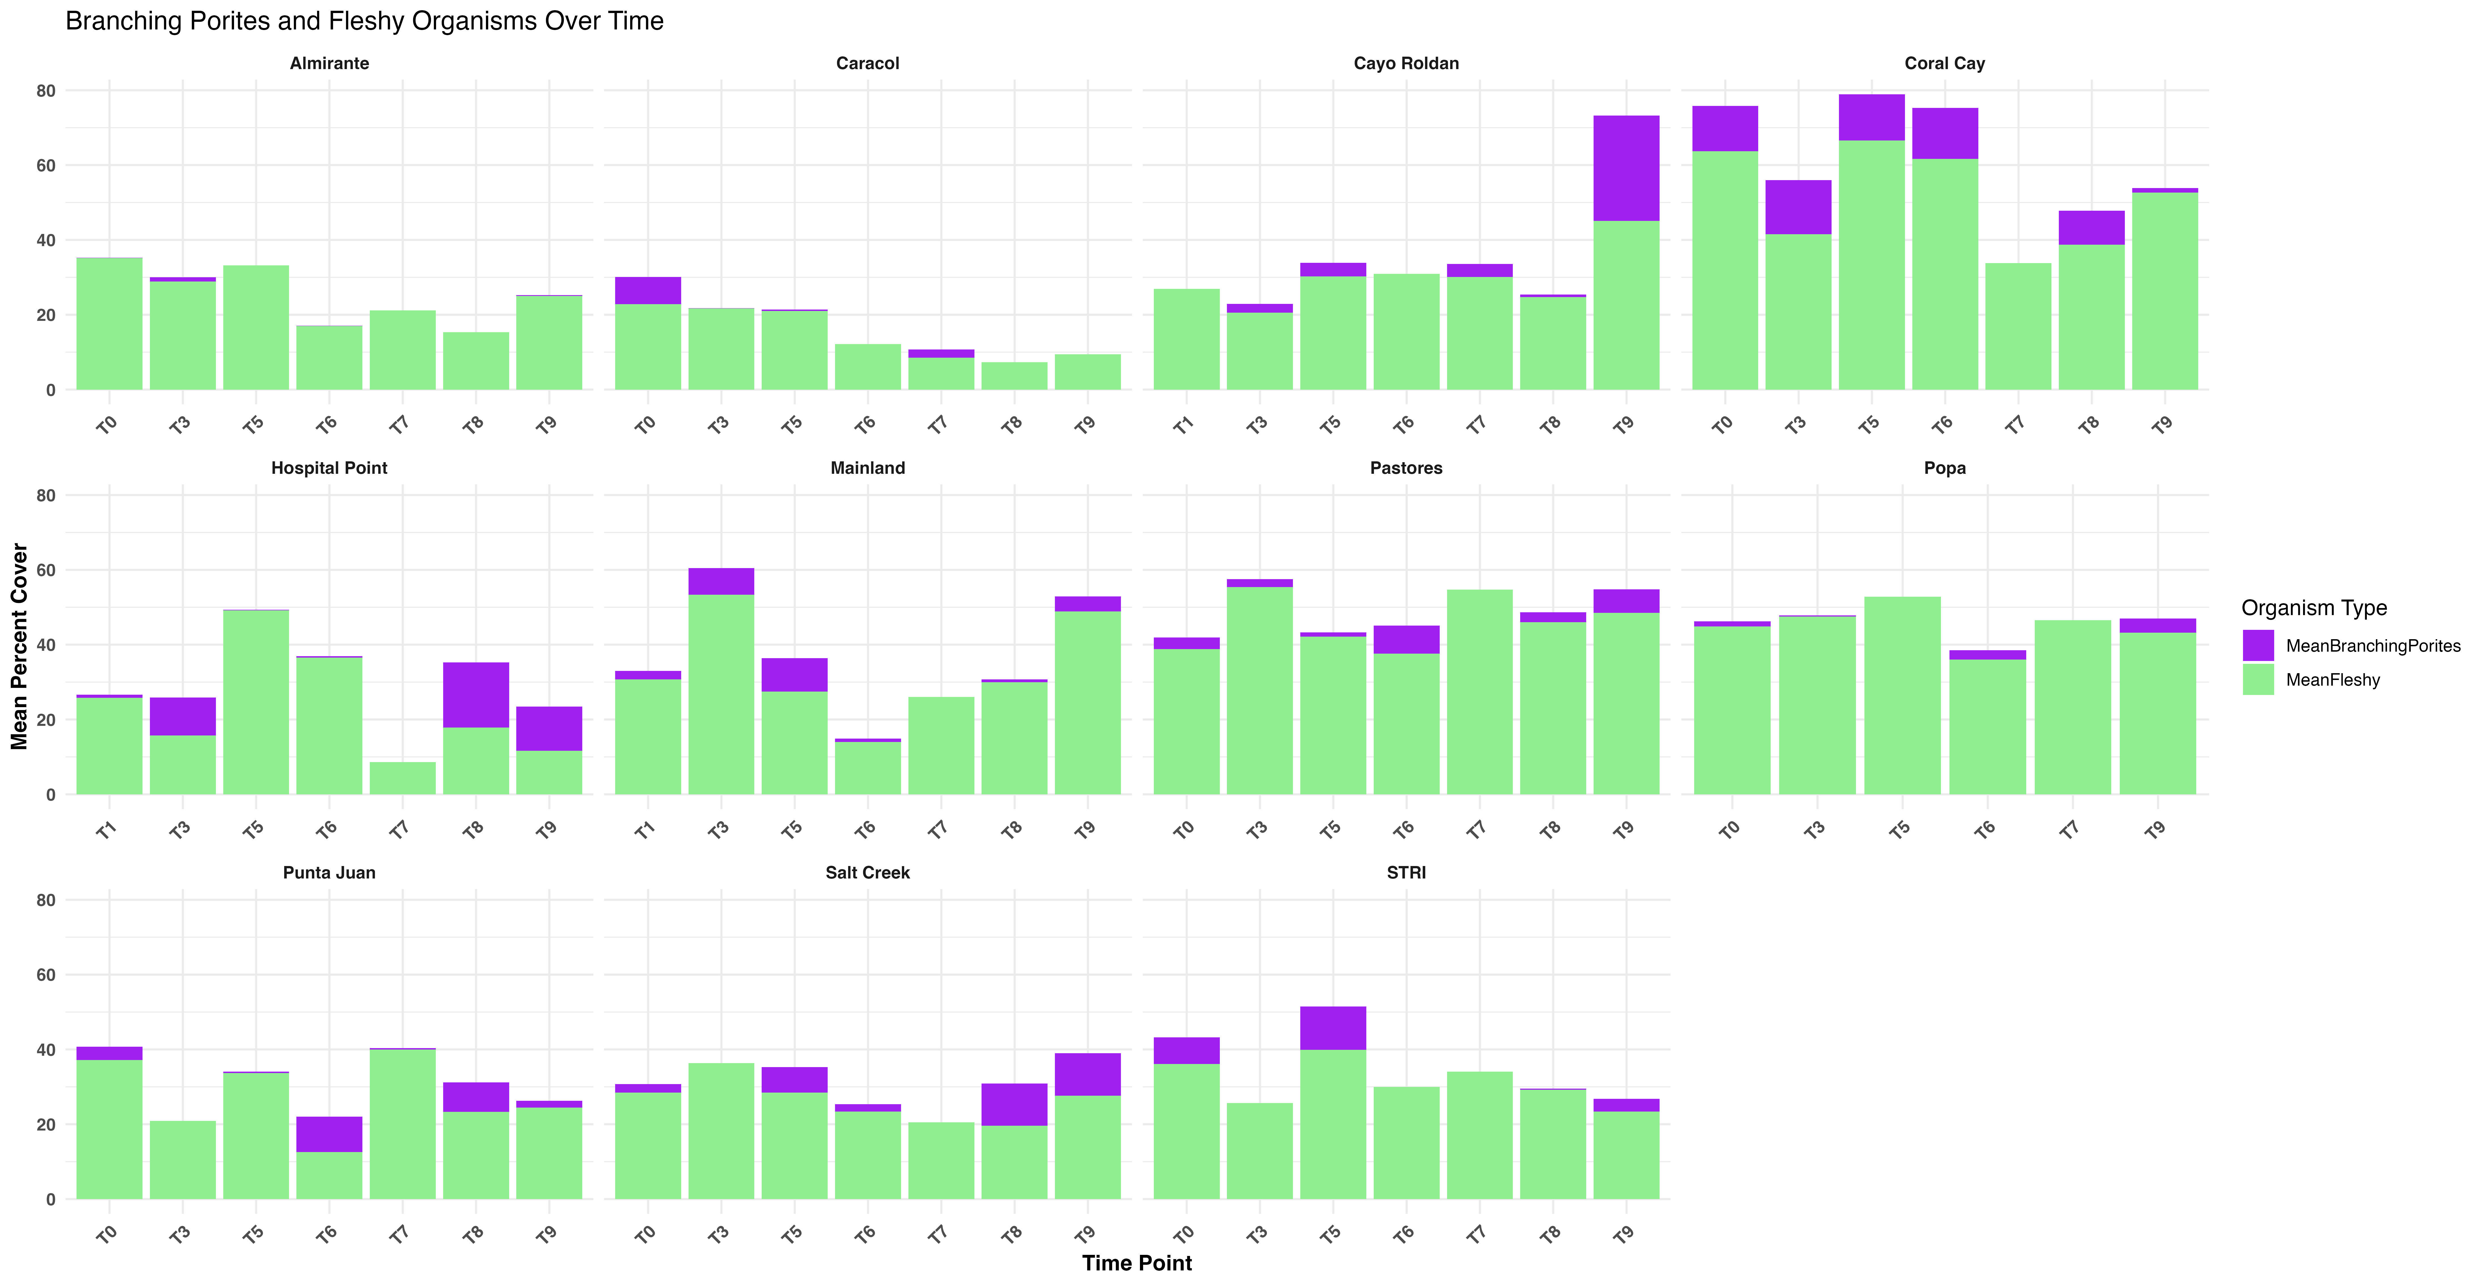

Slide 11
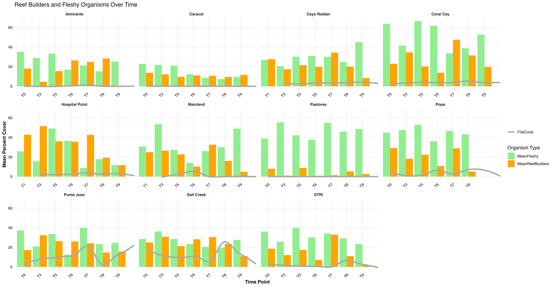

Slide 13
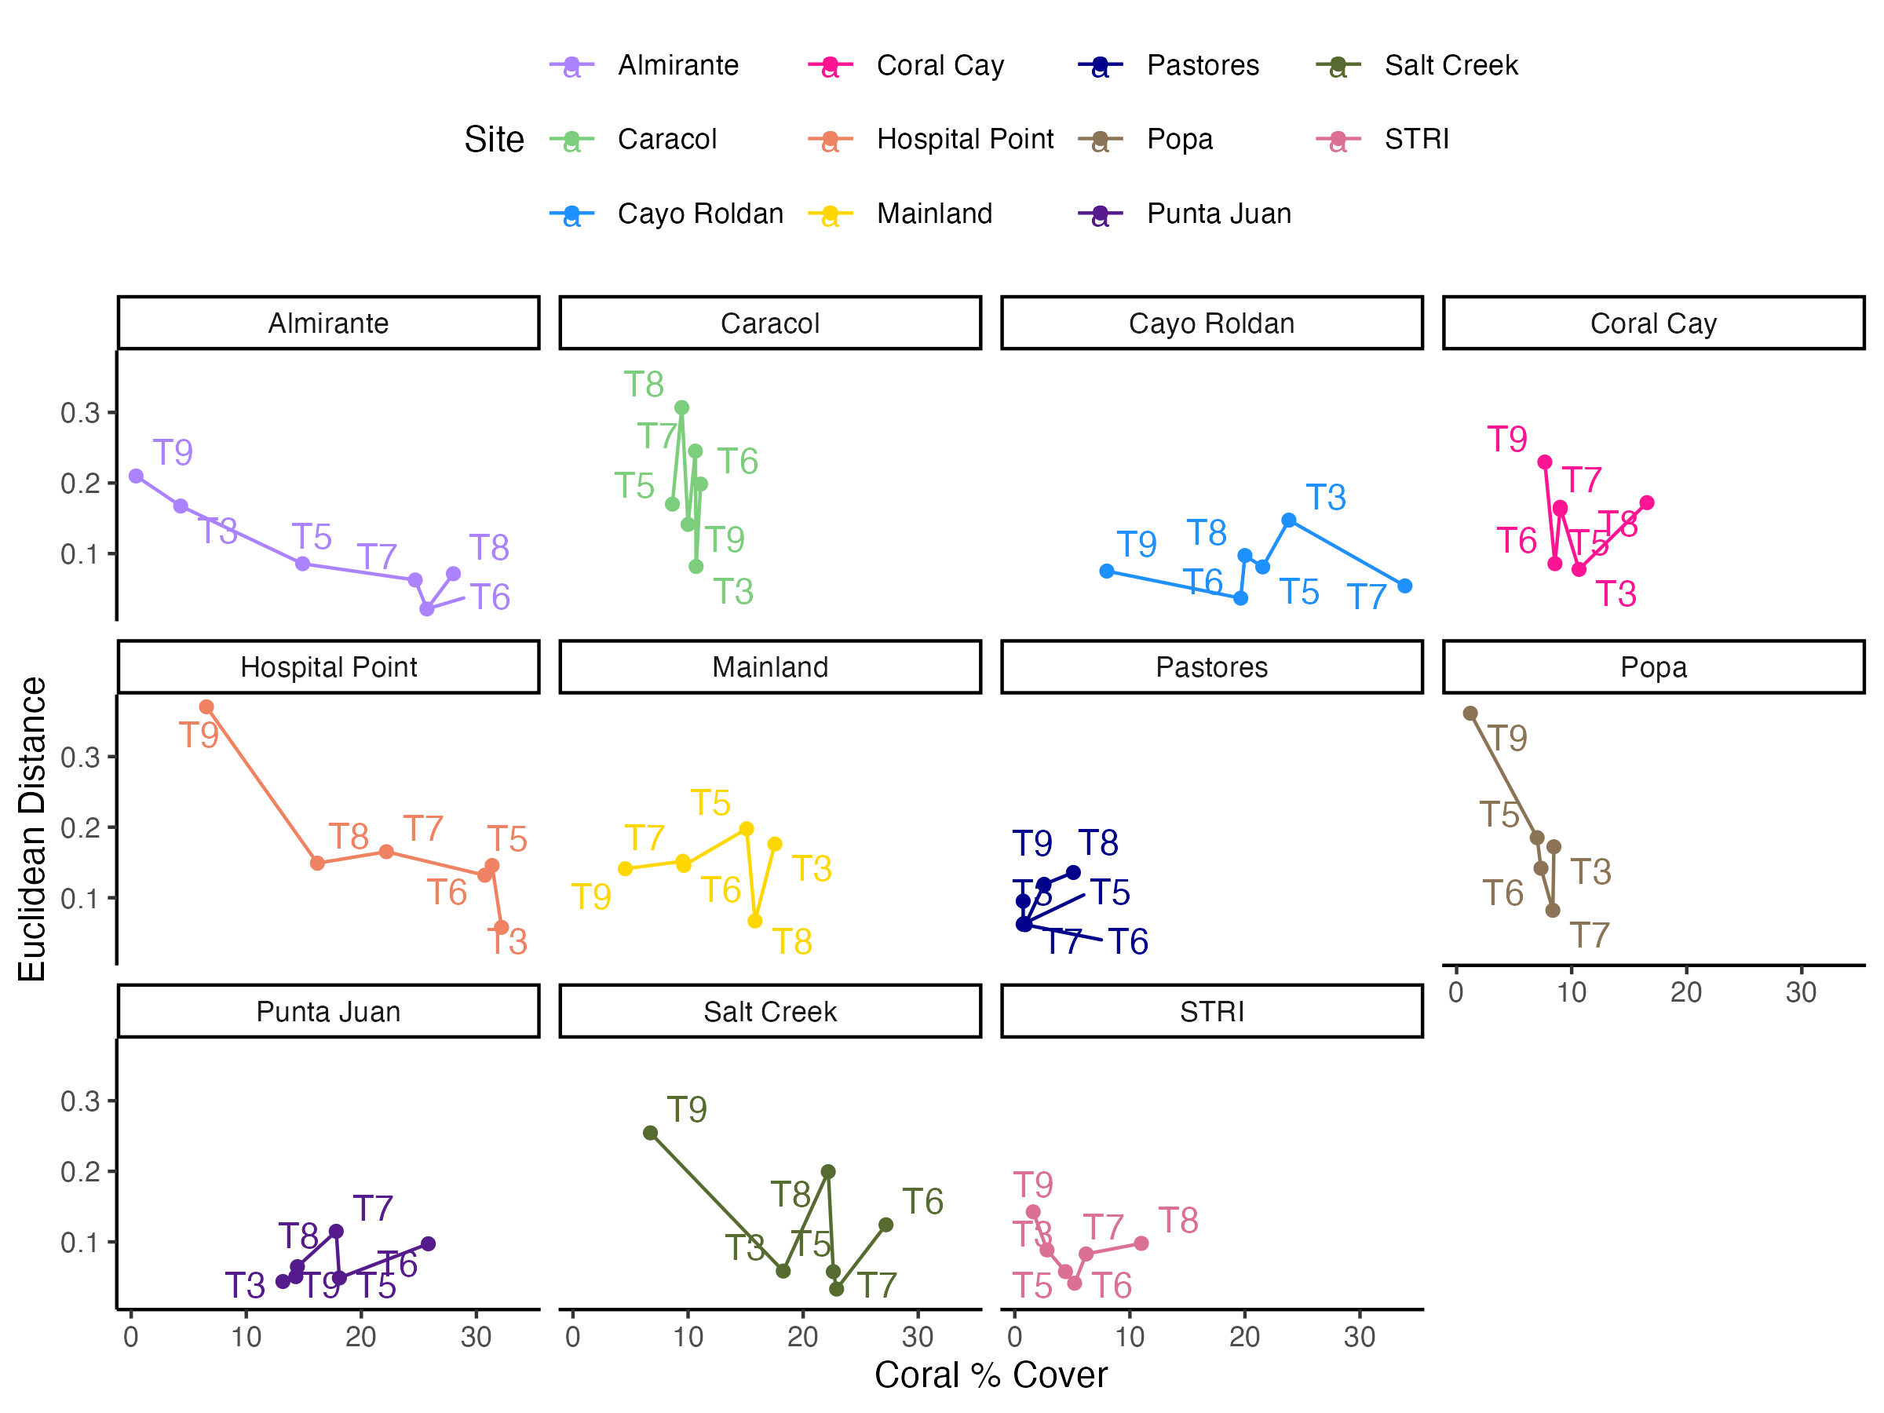

Slide 14
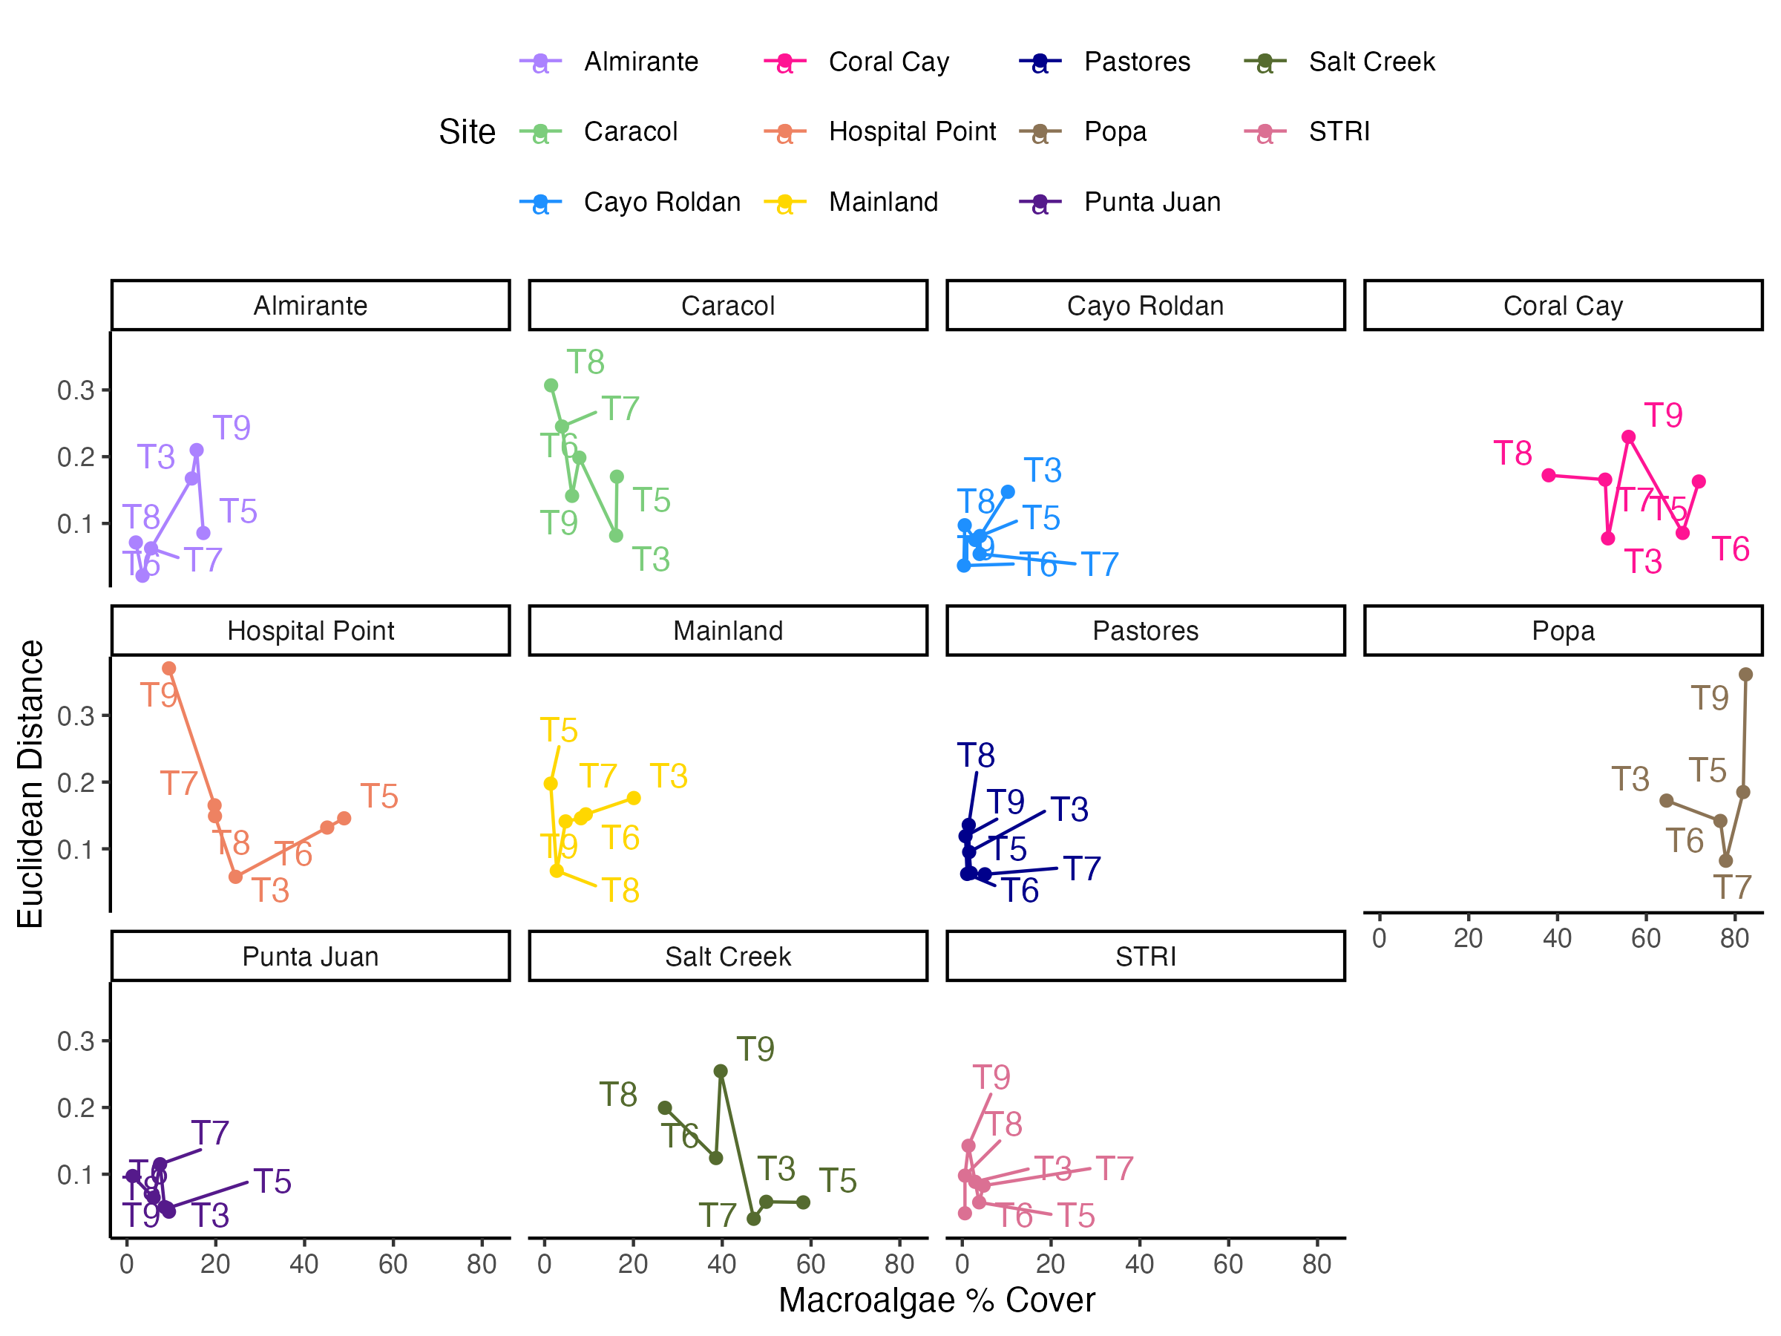

Slide 15
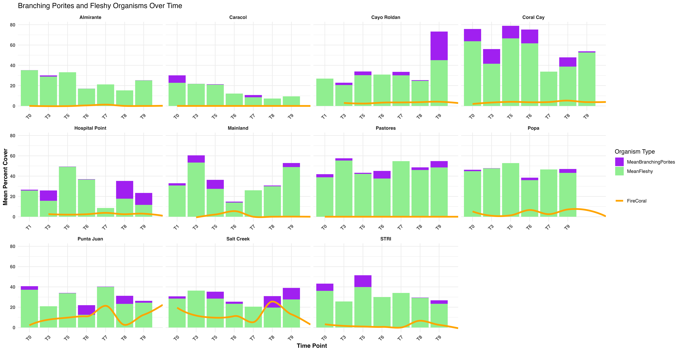

Slide 16
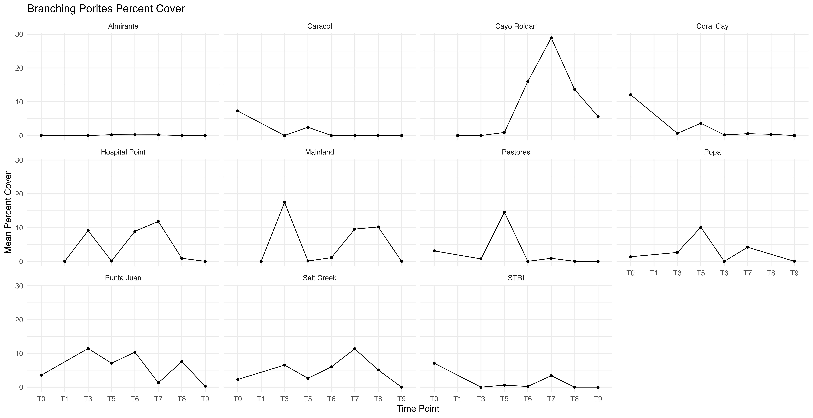

Slide 17
